Slide 1
Astro-nots
Lab #8
KestrelSAT Capstone
Preliminary Data Review
Notes:
https://www.youtube.com/watch?v=jVXgWGK9Kr8

Slide 2
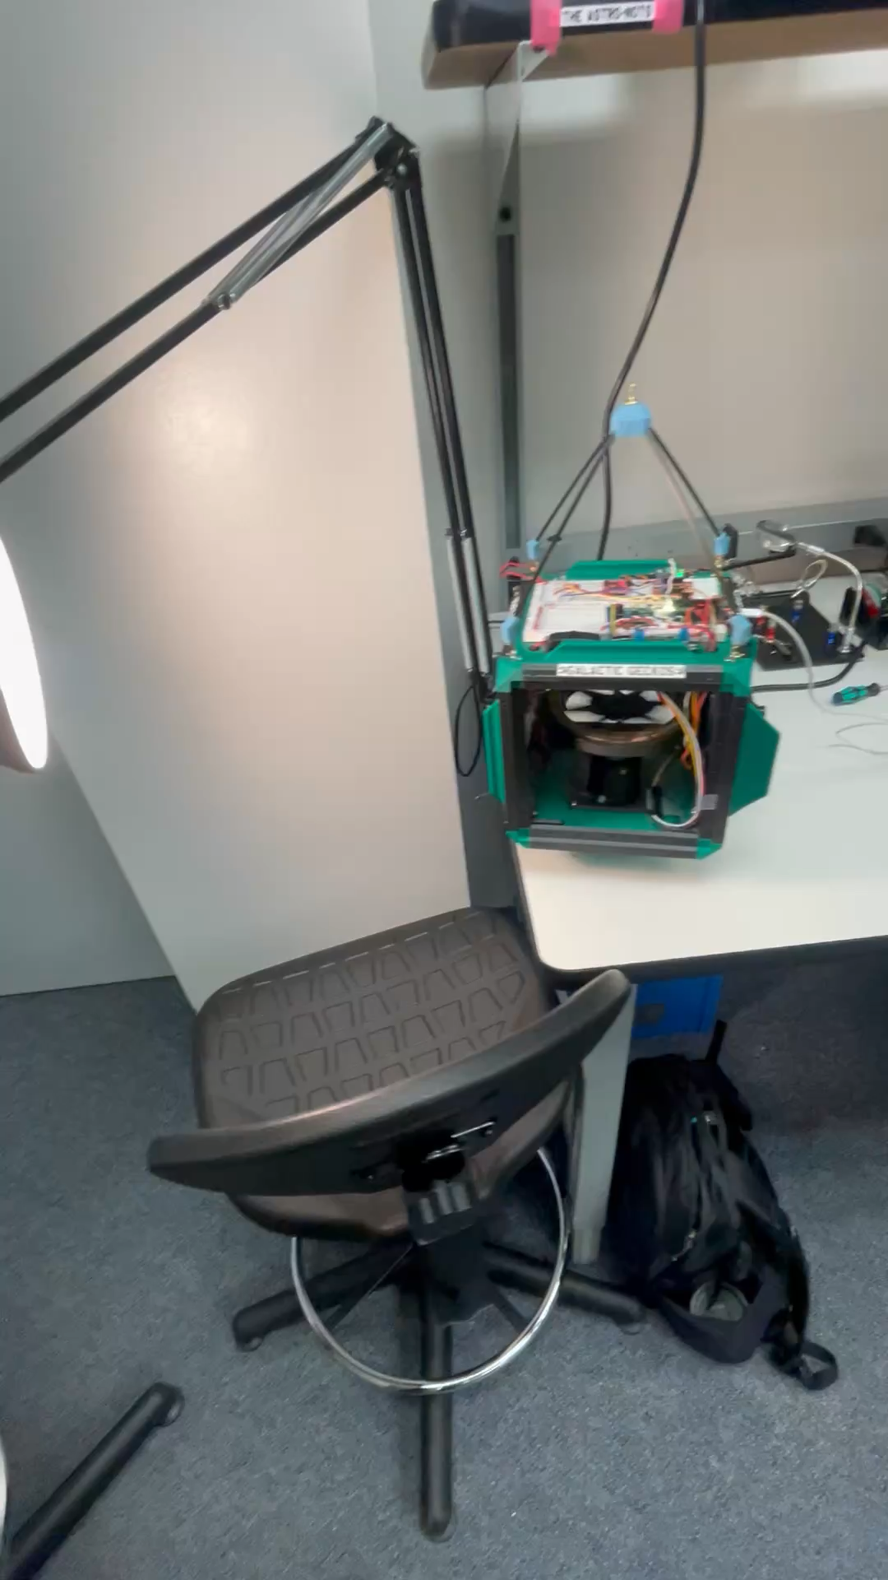
Overview
Why this matters
Requirements
Progress, Data, Plots, & Analysis
Plan Forward

Slide 3

Application – Why does it matter?
Maximize Power Generation
  Keeping the solar array normal within 10° is essential to maintain a positive power budget and powering the satellite to complete its mission
Demonstrate an Effective Attitude Determination and Control System
  Essential for success of many different missions such as imaging, antenna pointing, etc.
Extending Mission Life
  Desaturating reaction wheels via mechanical means preserves fuel and extends the mission life of the spacecraft

Slide 4
Requirements
Requirement | Verification Method | Status at Review
While in sunlight, the KestrelSAT shall keep the solar array normal within 10° of the Sun vector. | During testing, mount KestrelSAT and measure the distance between the solar array normal and the Sun vector. Monitor the distance to ensure that they are within 10° of each other. | In progress: KestralSAT does not reliably hold 10° accuracy.
From an initial error of 180° away from the Sun vector, the KestrelSAT's solar array normal vector shall reach the Sun vector within 10 seconds, while maintaining the pointing accuracy requirement. | During testing, when there is an initial error of 180°, ensure KestrelSAT reaches the Sun vector within 10 seconds while maintaining the pointing accuracy requirement of 10°. | In progress: KestralSAT does not consistently commit to a direction to rotate to. Additionally, during the rotation the reaction wheel saturates, preventing further accuracy.
The KestrelSAT shall maintain the pointing accuracy requirement while subject to external torques up to 2 Nm. | During testing, mount KestrelSAT and apply a 2 Nm disturbance torque using fans. Monitor the pointing accuracy to ensure that it is within the 10° pointing requirement. | This requirement has not been tested.
Stretch: While in Sun pointing mode, the KestrelSAT shall have a net positive battery charge rate. | Command KestrelSAT into Sun pointing mode and monitor the power system to ensure a net postitive battery charge rate. | This requirement has not been tested.
Stretch: The KestrelSAT should desaturate its reaction wheels while maintain the pointing accuracy requirement. | During testing, KestrelSAT successfully desaturates its reaction wheel. Monitor the pointing accuracy to ensure that it is within the 10° pointing requirement. | This requirement has not been tested.

Slide 5
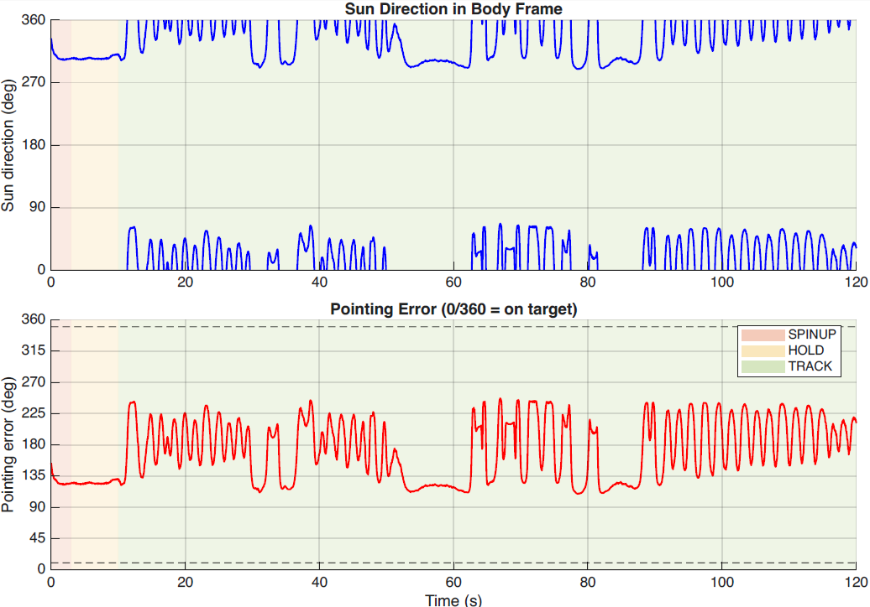
Test 51
Test Parameters: 10kΩ resistance on all sensors
0-10s: S/C is initializing
10s-End of test: S/C is oscillating between 135° and 225° pointing error.

Slide 6
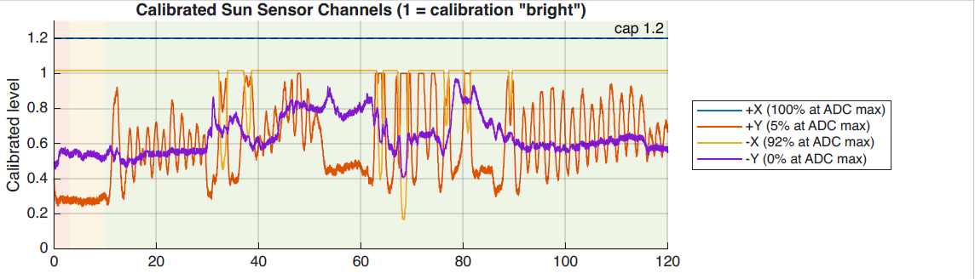
Test: 51 sun sensor
-x is not reporting meaningful data

Slide 7
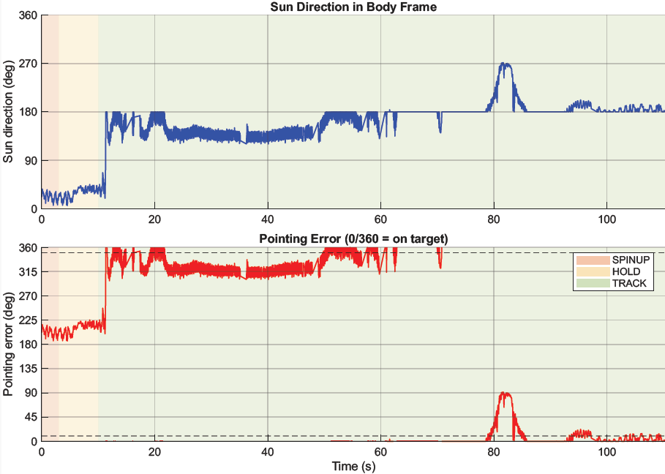
Test: 52
Test 52: Most recent, 20kΩ
0-10s: S/C is initializing
10s: Sun is detected 15 ° (opposite solar array)
10-20s: S/C slews to face Sun
20s: React wheel saturates, unable to hold S/C on point
20-50s: Reaction wheel struggles to hold S/C on target, repeatedly saturating.
50-end of test: Data shows S/C as unusually accurate. Specific cause isn’t known. We suspect an intermittent loss of valid readings. Could be from sensor issues, software issues, or both.

Slide 8
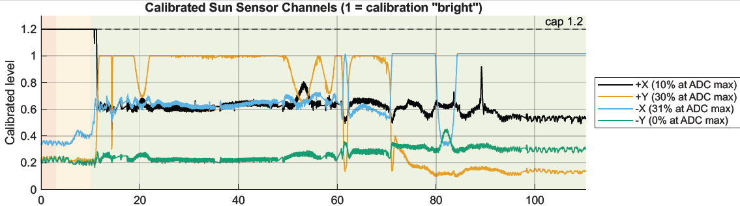
Test: 52 sun sensor
+x Now reports meaningful data. This issue, while resolved by changing resistors, could point to an issue with the sensor or our wiring.

Slide 9
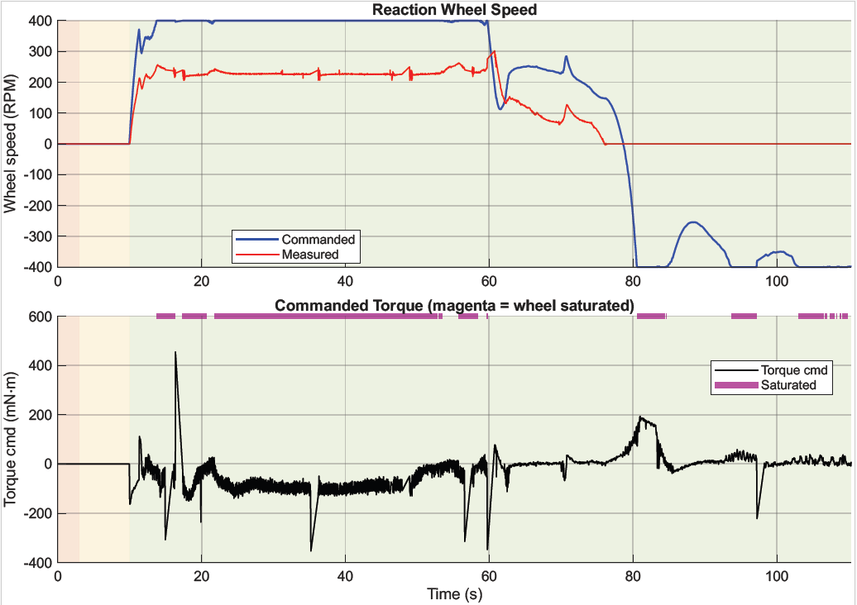
Test: 52 reaction wheel
Test 52: Most recent, 20kΩ
0-10s: S/C is initializing
10s: Sun is detected 15 ° (opposite solar array)
10-20s: S/C slews to face Sun
20s: React wheel saturates, unable to hold S/C on point
20-50s: Reaction wheel struggles to hold S/C on target, repeatedly saturating.
50-end of test: Data shows S/C as unusually accurate. Sensor Saturate

Slide 10
Comparison

Slide 11
Issues / Causes / Fixes
Current Issues | Likely Causes | Potential Fixes
Sensors do not track the sun reliably | Disturbance torque from USB cable Sun sensors oversaturated | Ensure the satellite can be commanded by XBee radio Test various resistors across the photo diodes Fully clear the LOS of each sensor Move each photo diode to each face, equidistant from the center
Reaction wheel does not spin up when under battery power | Motor not receiving enough power (3.8V needs 4.5V) Code errors | Ensure fully charged battery levels before each test Install a boost converter to ensure voltage minimums are met
Satellite oscillates between the target | PD control loop Code errors Unstable sun tracking | Switch to PID control loop Fix sun sensor

Slide 12
Plan Forward
Fix the solar sensor issues (clean up wiring, equidistant measurements, test different resistance levels)
  Move to camera brightness sensor if reliability issues remain
Fix the power issue (boost converter?)
Fix the oscillation issue (PD -> PID?, fix solar sensor, ensure wireless control)
Add fans to mimic disturbance torque and record its limits

Slide 13
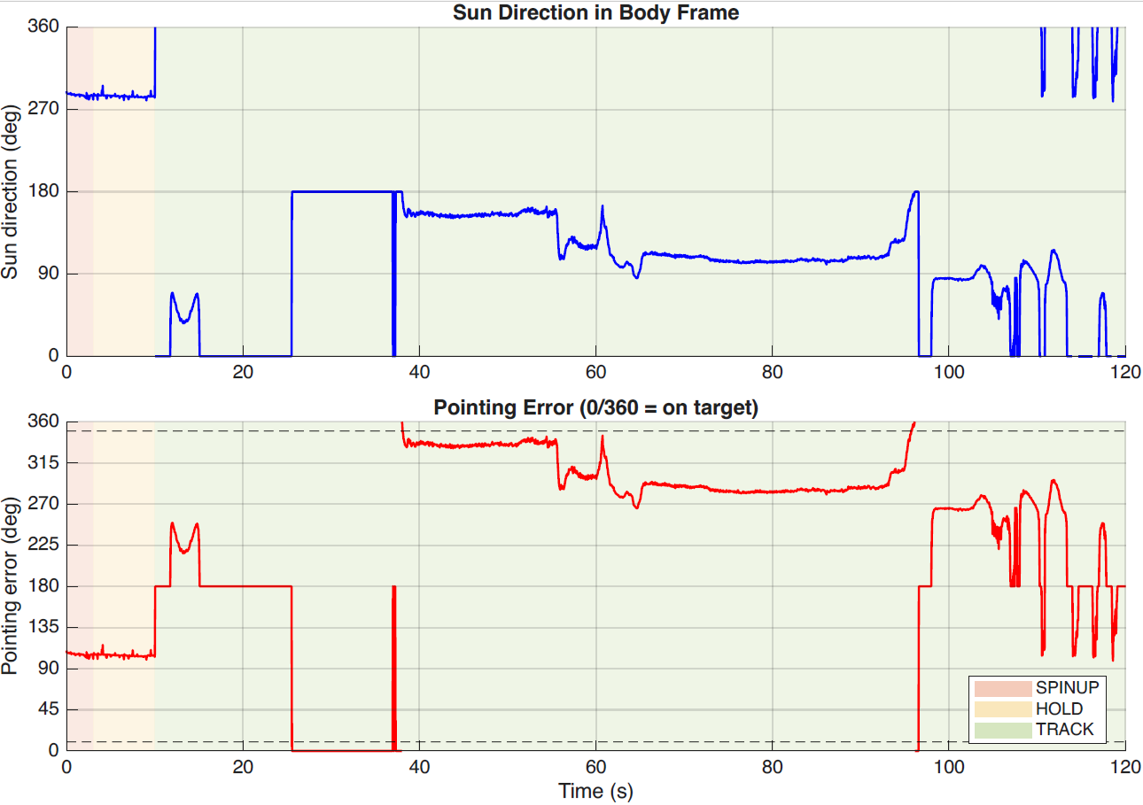
Test
Test 35: Software/sensor issues
0-10s: S/C is initializing
10-37s: S/C loses valid readings from sun sensor. Resorting to absolute 0° or 180°
40-90s: S/C regains valid readings. Saturates as it attempts to hold 180°. Note the 40° drop after 60s. Evidence of further motor/sensor/software deficiency’s.
90s-end of test: Intermittent loss of valid readings.

